Slide 1
PROJECT BASED INTERNSHIP PROGRAM
FINAL TASK
ID/X PARTNERS
MUHAMMAD RIZKY ANUGRAH – DATA SCIENTIST ID/X PARTNERS

Slide 2

Daftar Isi
EXPLORATORY DATA ANALYSIS
DEFINING LABEL
FEATURE ENGINEERING
FEATURE SELECTION
HANDLING MISSING VALUES
FEATURE SCALING & ENCODING
MODELING TRAIN & EVALUATION
2
FINAL TASK ID/X PARTNERS

Slide 3
EXPLORATORY DATA ANALYSIS
3
FINAL TASK ID/X PARTNERS

Slide 4
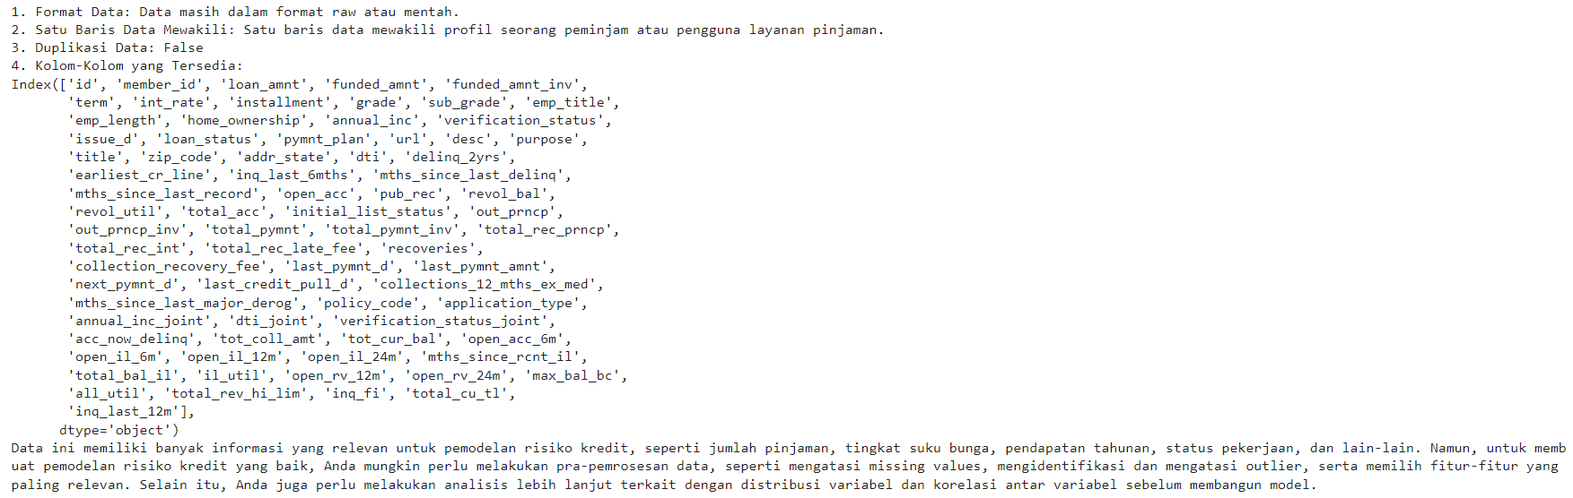
4
FINAL TASK ID/X PARTNERS

Slide 5
DEFINING LABEL
5
FINAL TASK ID/X PARTNERS

Slide 6
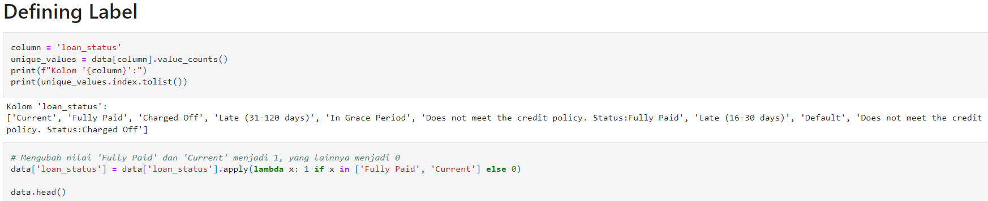
6
FINAL TASK ID/X PARTNERS

Slide 7
FEATURE ENGINEERING
7
FINAL TASK ID/X PARTNERS

Slide 8
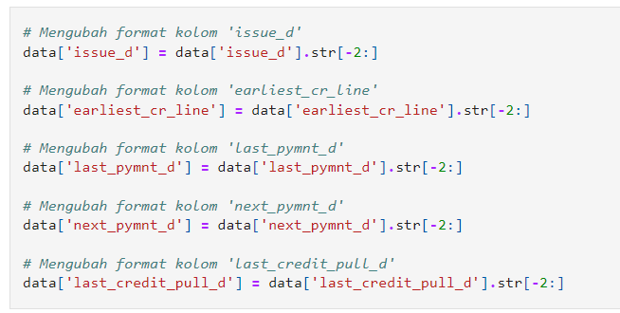
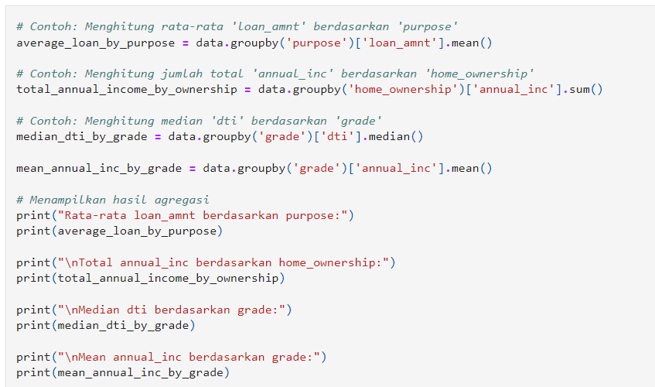
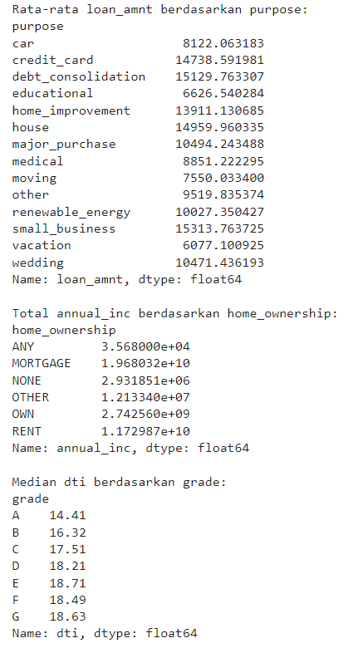
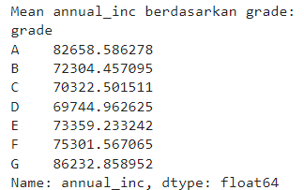
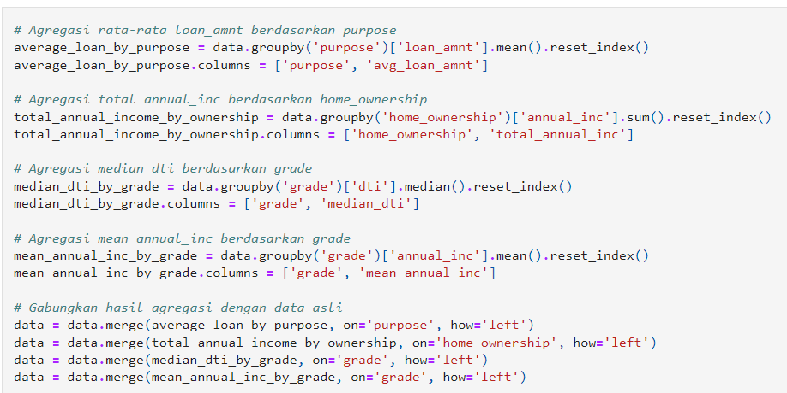
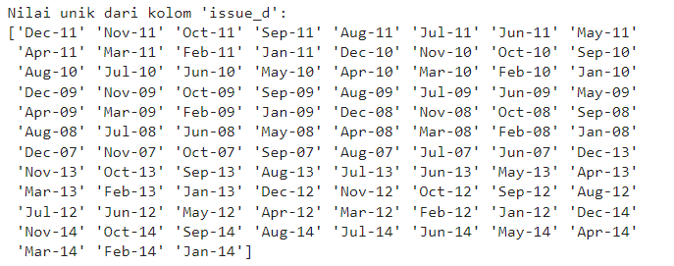
8
FINAL TASK ID/X PARTNERS

Slide 9
FEATURE SELECTION
9
FINAL TASK ID/X PARTNERS

Slide 10
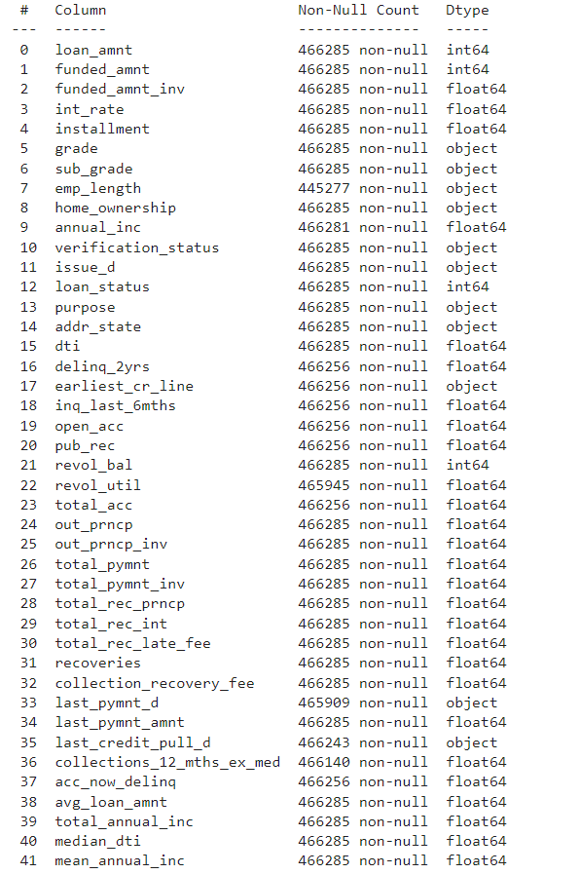
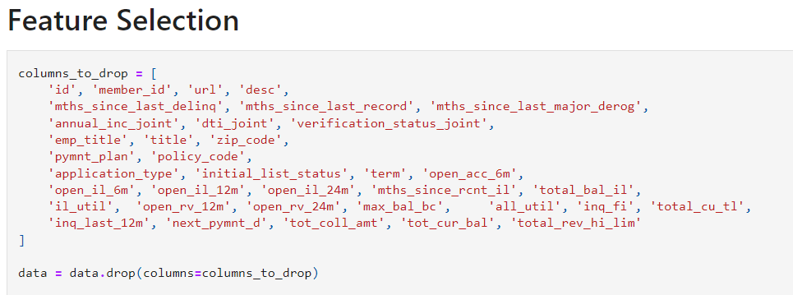
02
10
FINAL TASK ID/X PARTNERS

Slide 11
HANDLING MISSING VALUES
11
FINAL TASK ID/X PARTNERS

Slide 12
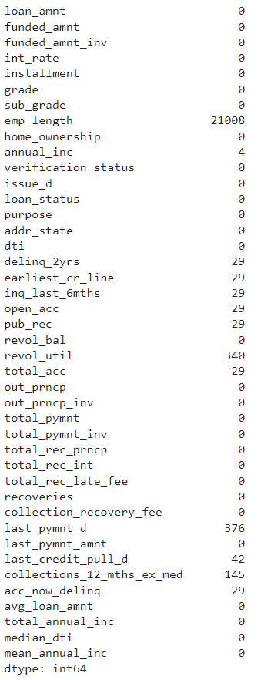
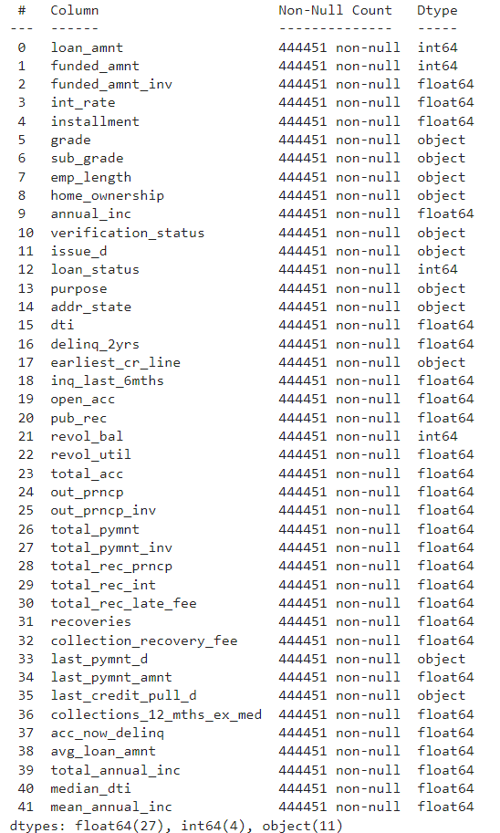
02
12
FINAL TASK ID/X PARTNERS

Slide 13
FEATURE SCALING & ENCODING
13
FINAL TASK ID/X PARTNERS

Slide 14
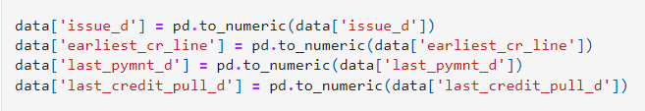
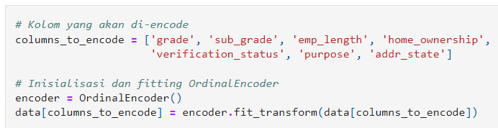
02
14
FINAL TASK ID/X PARTNERS

Slide 15
MODELING TRAIN & EVALUATION
15
FINAL TASK ID/X PARTNERS

Slide 16

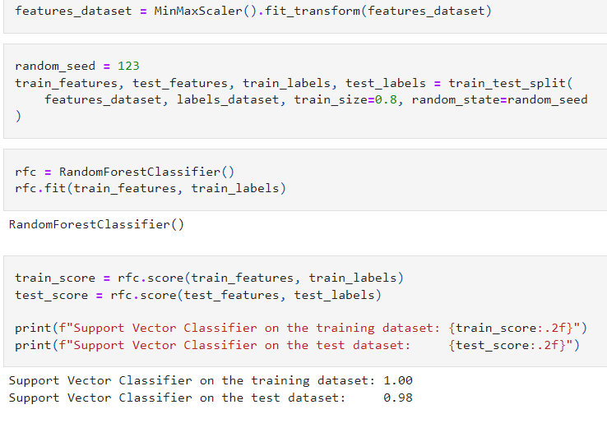
MODELING - TRAIN
16
FINAL TASK ID/X PARTNERS

Slide 17
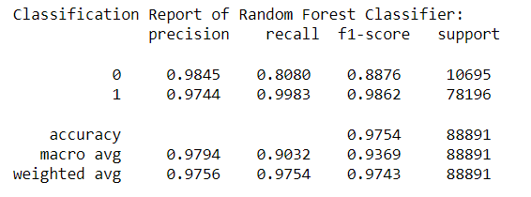
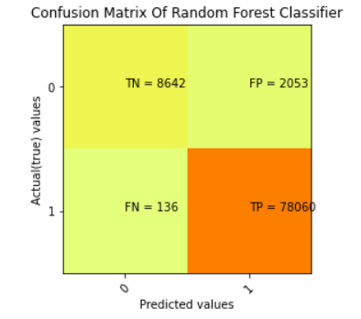
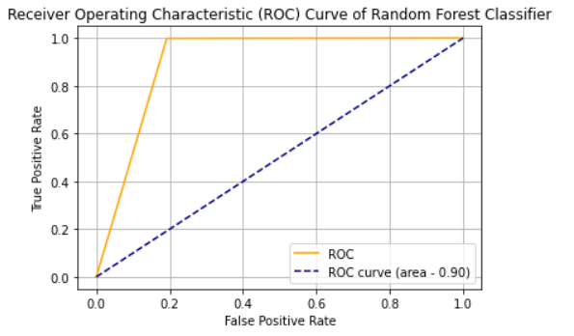
MODELING - EVALUATION
17
FINAL TASK ID/X PARTNERS

Slide 18
TERIMA KASIH !!!
18
FINAL TASK ID/X PARTNERS

